Slide 1


SILICON CARBIDE
A Comparative Analysis
Enabling Mobility Solutions
1

Slide 2
Contents
xEVs powertrain architectures
2. Power Electronics and its Importance
3. Si-IGBTs vs Si-MOSFETs
4. Need of shifting to Silicon Carbide based components
5. Conclusion
Enabling Mobility Solutions
Strictly Confidential

Slide 3
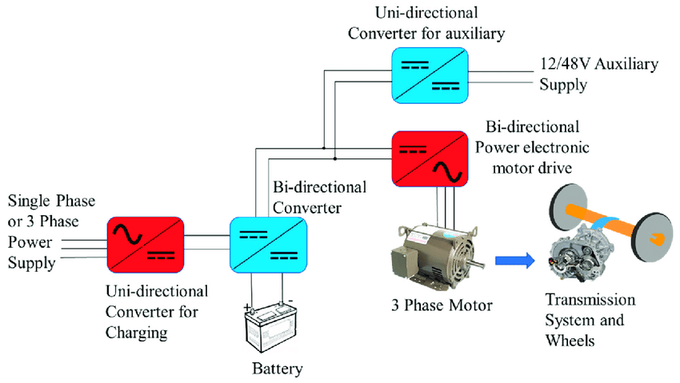
xEV Powertrain Architectures
Switching devices are the most prominent electronic devices used to control the power flow in an Electrified Vehicle. These are used in Buck-Boost Convertor, DC-DC Converters, Choppers, Inverters and Rectifiers.
Enabling Mobility Solutions
Strictly Confidential
3

Slide 4
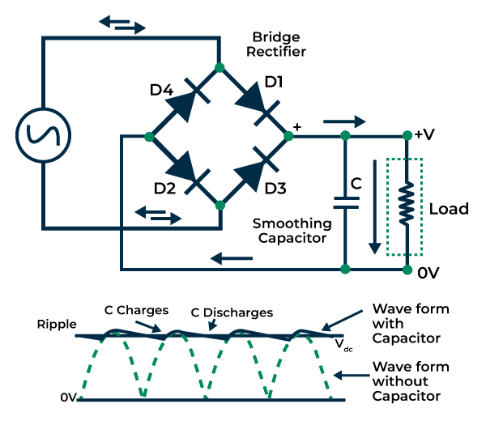
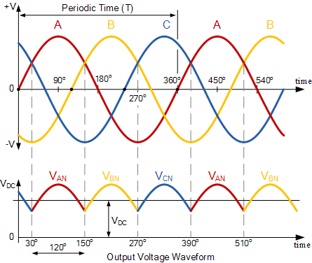
Power Electronics and its Importance
- Full-Bridge Rectifier:
The FBR is used to convert the AC charger input into DC voltage while charging the battery from the grid
Enabling Mobility Solutions
Strictly Confidential
3

Slide 5
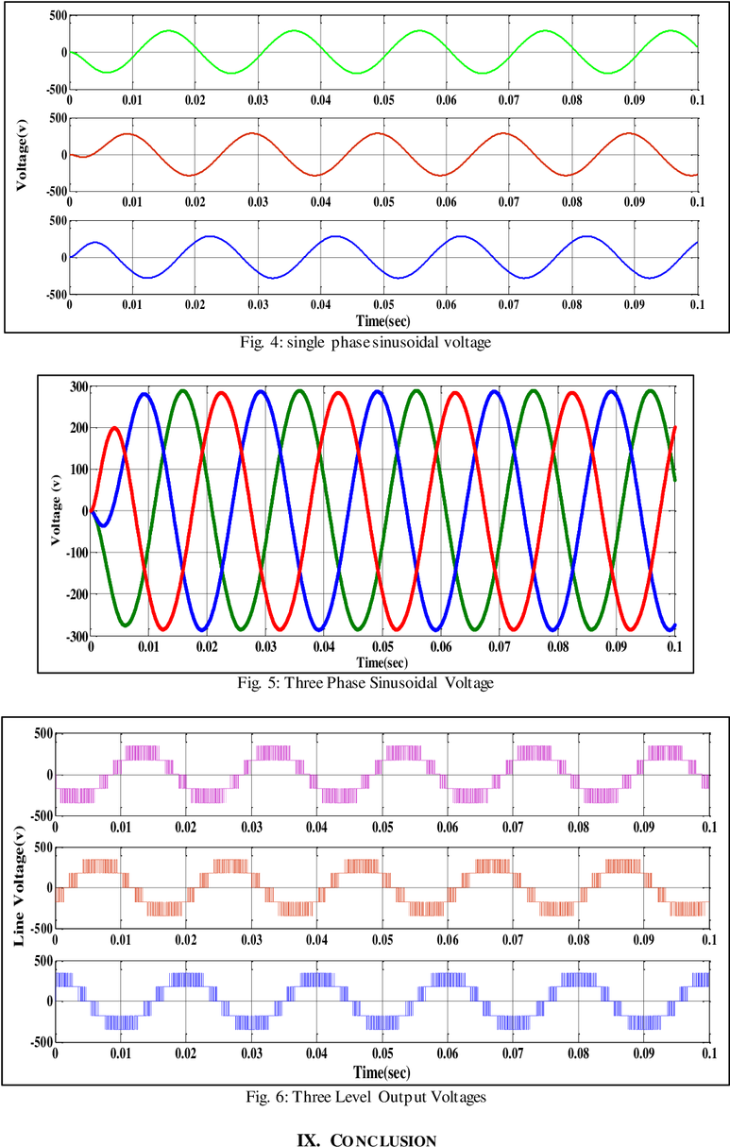
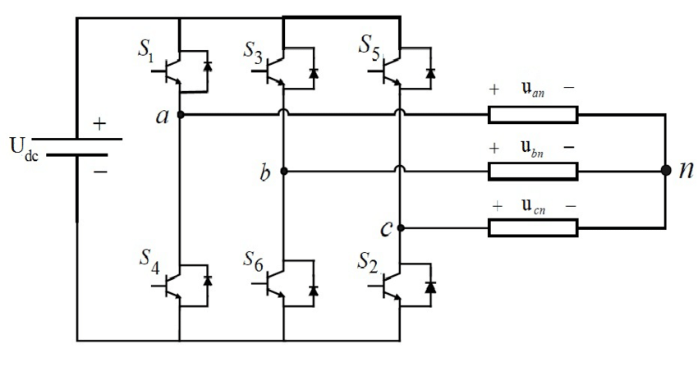
Power Electronics and its Importance
- 3-phase Inverter:
The motors usually used utilize 3-phase AC signal. This allows them to attain higher efficiency and power outputs
Enabling Mobility Solutions
Strictly Confidential
3

Slide 6
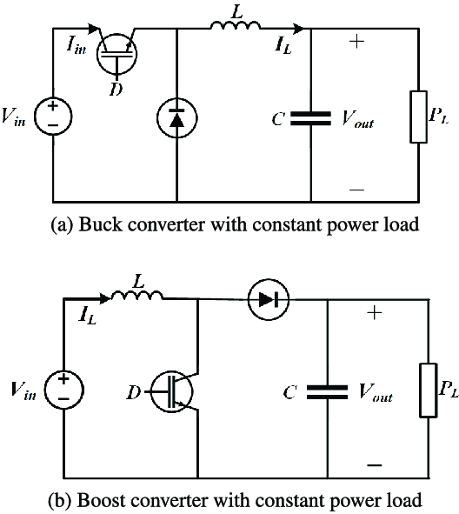
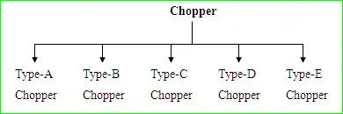
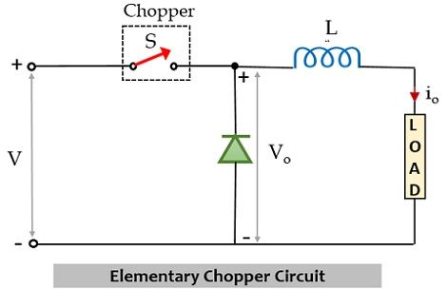
Power Electronics and its Importance
- DC-DC Converter:
The LV system of the vehicle uses 5V-12V and in a special case uses 48V (Tesla Cybertruck)
Enabling Mobility Solutions
Strictly Confidential
3

Slide 7
Types of Switching Devices
These switching devices help improve efficiency and performance of an EV by modulating the power flowing into the motor via various optimization techniques and control algorithms.
To achieve higher overall vehicle efficiency, the individual efficiencies of the converters play a major role and will help achieve lower GHG emissions.
The present switching devices are made from Silicon compounds:
1. MOSFET: Metal Oxide Semiconductor Field Effect Transistor
2. IGBT: Insulated Gate Bipolar Transistor
Enabling Mobility Solutions
Strictly Confidential
3

Slide 8
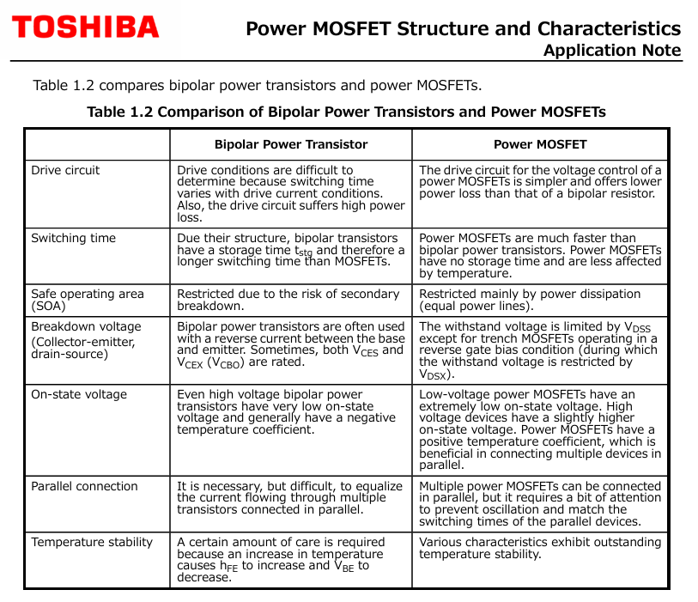
IGBTs vs MOSFETs
Enabling Mobility Solutions
Strictly Confidential
3

Slide 9
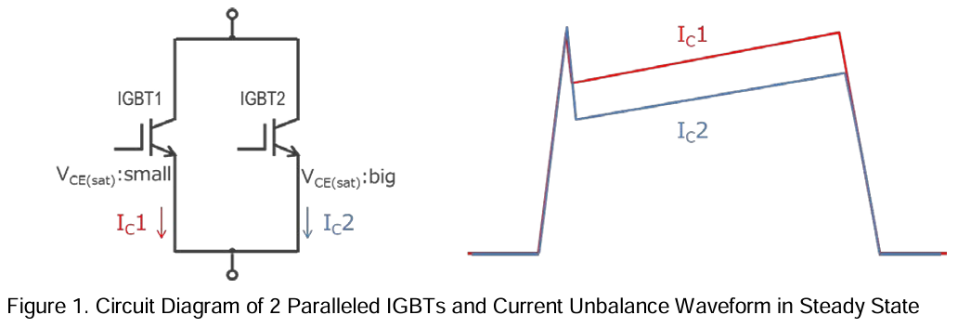
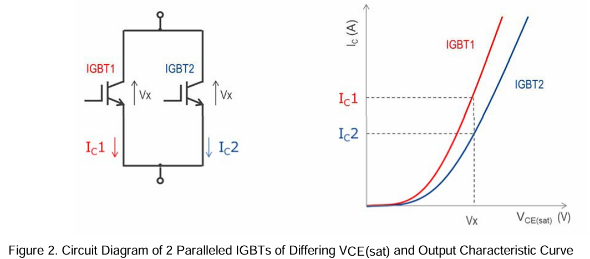
Si-IGBTs
As we increase the power of the Motors, we need to develop IGBTs that can sustain very high currents and ensure that this does not compromise the switching frequency requirements.
The easiest solution is to go for parallel IGBTs, this allows to double the current for the same phase without compromising the voltage. But it leads to some other critical issues.
Enabling Mobility Solutions
Strictly Confidential
3

Slide 10
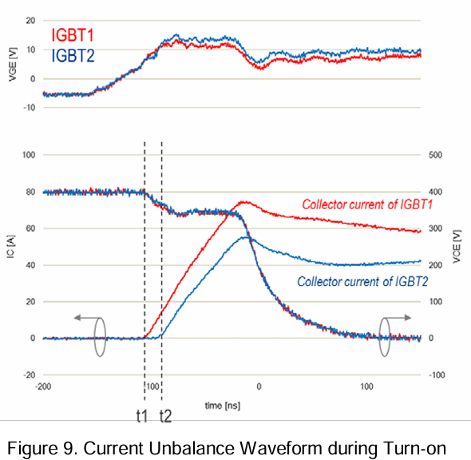
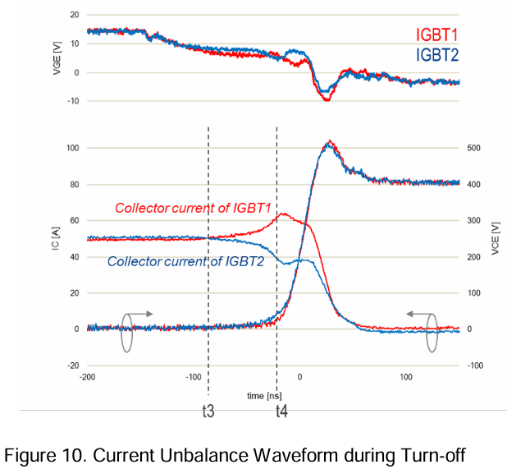
Si-IGBTs
Enabling Mobility Solutions
Strictly Confidential
3

Slide 11
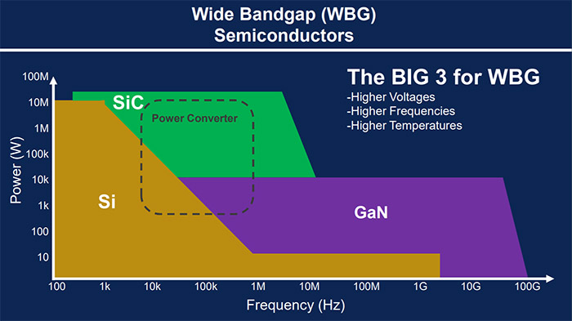
Si-IGBTs vs Si-MOSFETs
Enabling Mobility Solutions
Strictly Confidential
3

Slide 12
Silicon Carbide Technology
Focus shifting towards Silicon Carbide
The advancements in power electronics has led us towards opting of Silicon Carbide MOSFETs over traditional Silicon MOSFETs or IGBTs. The following is a comparison between SiC MOSFET and Si IGBT
IGBTs are good in terms of Power Density and overall peak voltage and current values
IGBTs are susceptible to Thermal Runaway leading to Malfunction and Failures
SiC-MOSFETs improve their power density and performance aspects over traditional Si-MOSFETs, allowing them to perform equivalent or sometimes even better than IGBTs.
SiC also have the advantages of higher rate of heat dissipation and improved switching efficiencies.
Thermal systems can be downsized, allowing compact Power Modules with a lighter cooling systems.
SiC MOSFETs inherit the higher switching frequencies, enabling precise motor position control and improved control efficiency.
SiC allows for a unibody assembly of Motor-Controller-Inverter module, usually called as 3-in-1
This reduces the amount of HV cables and their housings which are bulky and posses a potential safety concern over long duration of usage.
Efficiency increases as temperature increases is the best possible scenario for the component
Enabling Mobility Solutions
Strictly Confidential
3

Slide 13
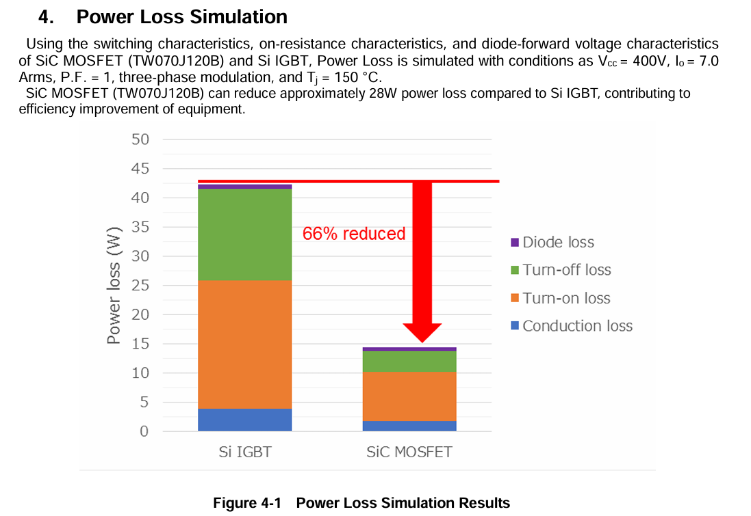
Silicon Carbide Technology
Simulation Parameters:
Vcc=400V
i0 = 7A
Power Factor = 1
Three Phase Modulation
Junction Temperature = 150*C
Enabling Mobility Solutions
Strictly Confidential
3

Slide 14
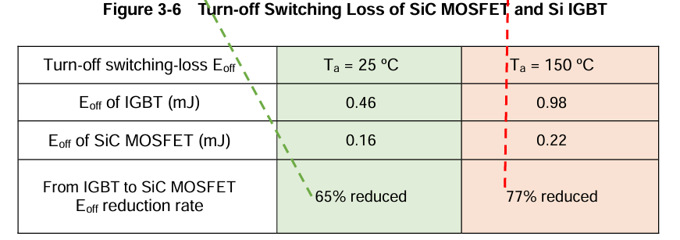
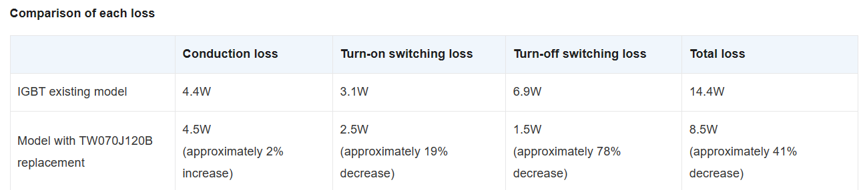
Silicon Carbide Technology
Enabling Mobility Solutions
Strictly Confidential
3

Slide 15
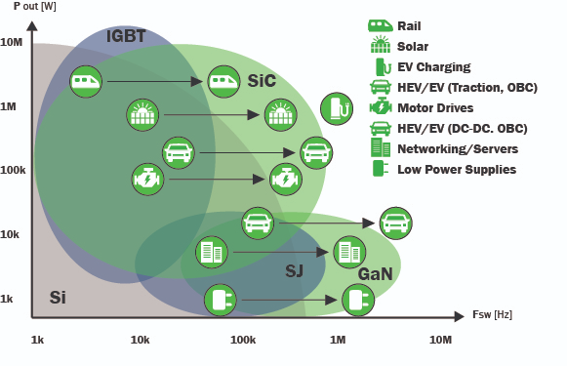
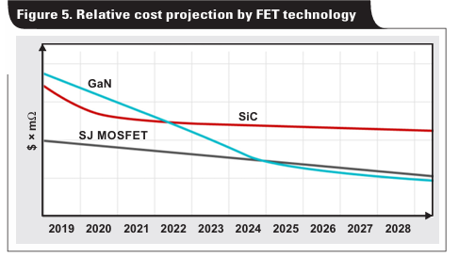
Gallium Nitride Technology
Extreme switching frequencies
Higher efficiency than Si-MOSFET
Compact with higher thermal conductivity
Relatively more expensive than Si
Suitable for CLLC, LLC Circuits
Fast Chargers and DC-DC Converters upto 25kW
Enabling Mobility Solutions
Strictly Confidential
3

Slide 16
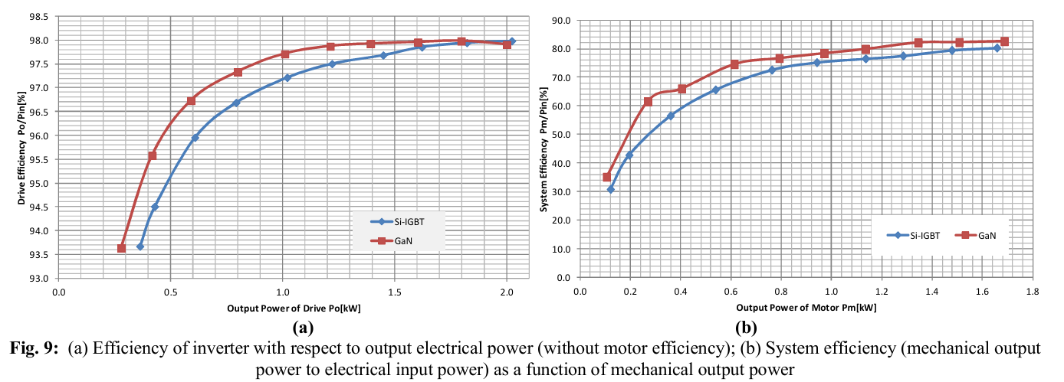
Gallium Nitride Technology
IGBTs are inefficient when its in low power category.
IGBTs overtake GAN after a “X” kW figure
PCBs and Passenger Vehicles benefit from these features where low packaging volume and high efficiency is needed
Reliability and Cost is the main issue which will be resolved in the upcoming years.
Enabling Mobility Solutions
Strictly Confidential
3

Slide 17
Gallium Nitride Technology
The CO2 footprint to manufacture and ship GaN is up to 10x lower than silicon and reduces end application footprint by up to 30%.
Improvements in the performance of electric vehicles (EVs) could accelerate worldwide EV adoption by three years and save up to 20% of road-sector emissions by 2050
Each GaN power IC shipped saves net 4 kg CO2,
GaN offers the potential to address a reduction of
2.6 Gtons CO2 /year by 2050
Enabling Mobility Solutions
Strictly Confidential
3

Slide 18
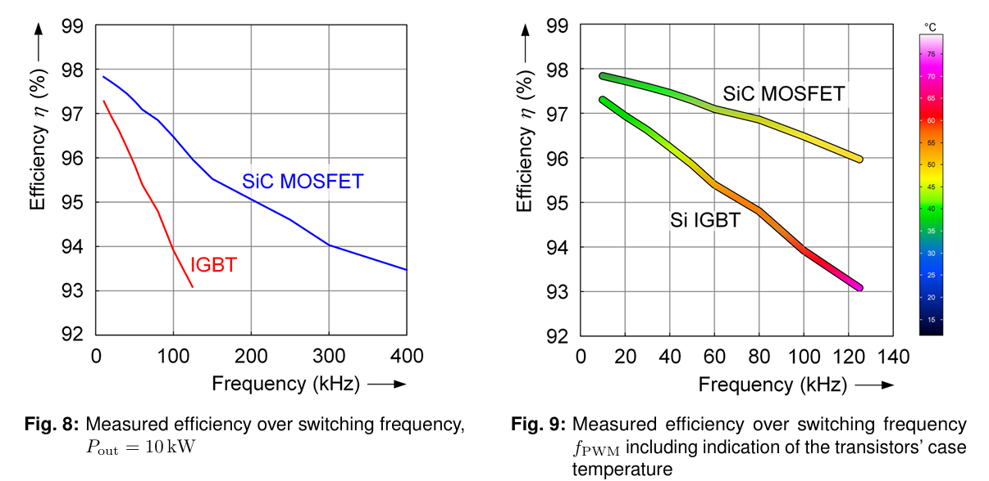
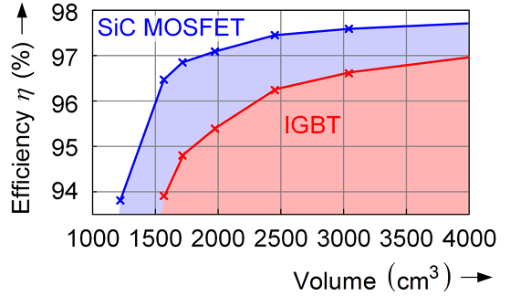
Comparison between Silicon and Silicon Carbide
The much greater achievable switching frequency of the SiC MOSFET means that we can decrease the size of the overall system by over 20% compared to a Si IGBT based inverter.
Enabling Mobility Solutions
Strictly Confidential
3

Slide 19
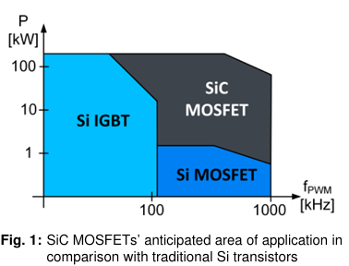
Benefits and Conclusions
Better Efficiency —> Higher Range per kWhr —> Lower Cooling Circuit Volume and Components —> Lower number of cells inside the pack —> Lower the weight of battery pack —> Lower the loads on chassis and support structures —> Lower BIW weight and complexity —> Lower R&D cost —> Lower Manufacturing Costs.
Enabling Mobility Solutions
Strictly Confidential
3

Slide 20
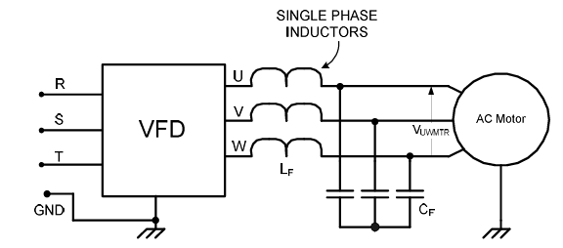

Benefits and Conclusions
With higher switching frequencies, we can reduce the filter component sizes. It will also help us reduce stray capacitances and inductances, thus making the response times better than previous.
Enabling Mobility Solutions
Strictly Confidential
3

Slide 21
References
[1] https://toshiba.semicon-storage.com/info/application_note_en_20180726_AKX00061.pdf?did=13413
[2] https://www.renesas.com/us/en/document/apn/usage-notes-paralleled-igbt
[3] https://toshiba.semicon-storage.com/info/application_note_en_20200817_AKX00087.pdf?did=69799
[4] https://www.engineering.com/story/si-sic-and-gan-for-power-devices-part-two-igbts-si-mosfets-super-junction-si-mosfets-and-sic-mosfets
[5] https://www.powerelectronicsnews.com/3-pen-ebook-dec-21-gan-technology-challenges-and-future-perspectives/
[6] https://navitassemi.com/sustainability-and-gan/
[7] https://gansystems.com/newsroom/article/paralleled-gan-transistors-boost-converter-power-100kw/#:~:text=Paralleling%20GaN%20transistors%20increases%20the,those%20associated%20with%20interfacing%20circuits.
[8] https://www.arrow.com/en/research-and-events/articles/silicon-carbide-and-gallium-nitride-compared
[9] https://toshiba.semicon-storage.com/ap-en/semiconductor/product/mosfets/sic-mosfets/articles/loss-comparison-between-sic-mosfet-and-si-igbt.html

Slide 22

Thank You
Enabling Mobility Solutions
Strictly Confidential
6
TACO Prestolite Electric Pvt Ltd

